Slide 1

Alepo- Overview of Helm & Repo Setup
Presented to CASA systems | DD - MMM - YYYY

Slide 2
AGENDA

Slide 3
Agenda
Introduction to Helm
Using Helm
Basic Helm Commands
Adding Helm Repo
How to Upload Help Charts
Credential Creation

Slide 4
Introduction to Helm
Helm is a tool for managing Kubernetes packages called charts. Helm can do the following:
  Create new charts from scratch
  Package charts into chart archive (tgz) files
  Interact with chart repositories where charts are stored
  Install and uninstall charts into an existing Kubernetes cluster
  Manage the release cycle of charts that have been installed with Helm

Slide 5
Using Helm
For Helm, there are three important concepts:
  1. The chart is a bundle of information necessary to create an instance of a Kubernetes application.
  2. The config contains configuration information that can be merged into a packaged chart to create a releasable object.
  3. A release is an Instance of a chart running in a Kubernetes cluster. One chart can be installed many times into the same cluster, each time it is installed new release gets created.

Slide 6
Using Helm
Helm is an executable which is implemented into two distinct parts:
The Helm Client is a command-line client for end users. The client is responsible for the following:
  Local chart development
  Managing repositories
  Managing releases
  Interfacing with the Helm library
    Sending charts to be installed
    Requesting upgrading or uninstalling of existing releases
The Helm Library provides the logic for executing all Helm operations. It interfaces with the Kubernetes API server and provides the following capability:
  Combining a chart and configuration to build a release
  Installing charts into Kubernetes, and providing the subsequent release object
  Upgrading and uninstalling charts by interacting with Kubernetes
  The standalone Helm library encapsulates the Helm logic so that it can be leveraged by different clients.

Slide 7
Basic Helm Commands
  helm repo add : Adding helm repository
    $ helm repo add <repo_name> <URL>
  helm repo update: Updating metadata of repository
    $ helm repo update
  helm repo list: Listing added repositories
    $ helm repo list
  helm search : Finding charts
  helm search repo : searches the repositories that you have added to your local helm client ( with helm repo add )
    $ helm search repo <chart_name>
  Searching available packages using parts of words or phrases:
    $ helm search repo <string>

Slide 8
Basic Helm Commands
helm install : Installing a package
  Installing chart using values supplied from a supplied file
    $ helm install -f <file_name> --name-template <release_name> --namespace <namespace> <chart_name>
  Installing chart supplying values from CLI
    $ helm install --set <parameter_1>=<value_1> --set <parameter_2>=<value_2> --name-template <release_name> --namespace <namespace> <chart_name>
  Installing chart with variable supplied from both files and from CLI
    $ helm install --set <parameter_1>=<value_1> --values <file_name> --name-template <release_name> --namespace <namespace> <chart_name>
    values supplied from CLI will override parameter values present within values file
  helm list: Listing installed packages with details
    $ helm list --namespace <namespace>
    These details include release name, revision, last updated timestamp, status, chart name with version, app version and namespace.
  helm get : Information from installed release
    Outputs kubernetes manifests that are installed in given release
      $ helm get manifest --namespace <namespace> <release_name>

Slide 9
Basic Helm Commands
Outputs values or parameters used while installed in given release
  $ helm get values --namespace <namespace> <release_name>
helm upgrade: Upgrading existing release
  $ helm upgrade <release_name> --namespace <namespace> --values <file_name> --set <parameter_1>=<value_1> <chart_name>
helm rollback : Rollback to previous release version
  $ helm rollback --namespace <namespace> <release_name> <revision_number>
helm history : Show entire revision history for release
  $ helm history --namespace <namespace> <release_name>
  helm delete : Delete existing release
    $ helm delete --namespace <namespace> --purge <release_name>
  helm dependency update : Installing chart dependency
    $ helm dependency update

Slide 10
Adding Helm Repository
  To use the helm files on the server, download the helm files from the harbor and use it along with the over-ride file, details of which is given below with all the NFs.
  Add helm Repository
  Add your helm repository so, helm charts can be accessed from server.
    helm repo add alepo <repo-url> --username '{user-name}' --password '{password}’
  Create ImagePullSecret
    For Authentication to pull images from your local private registry while deploying NFs, it is required to create a pull secret.
    kubectl create secret docker-registry regcred --docker-server=<your-registry-server> --docker-username='<your-name>' --docker-password='<your-password>' --docker-email=<your-email> -n <namespace>

Slide 11
Charts
Helm uses a packaging format called charts.
A chart is a collection of files that describe a related set of Kubernetes resources.
A single chart might be used to deploy something simple, like a memcached pod, or something complex, like a full web app stack with HTTP servers, databases, caches, and so on.
Charts are created as files laid out in a particular directory tree. They can be packaged into versioned archives to be deployed.
If you want to download and look at the files for a published chart, without installing it, you can do so with helm pull chartrepo/chartname

Slide 12
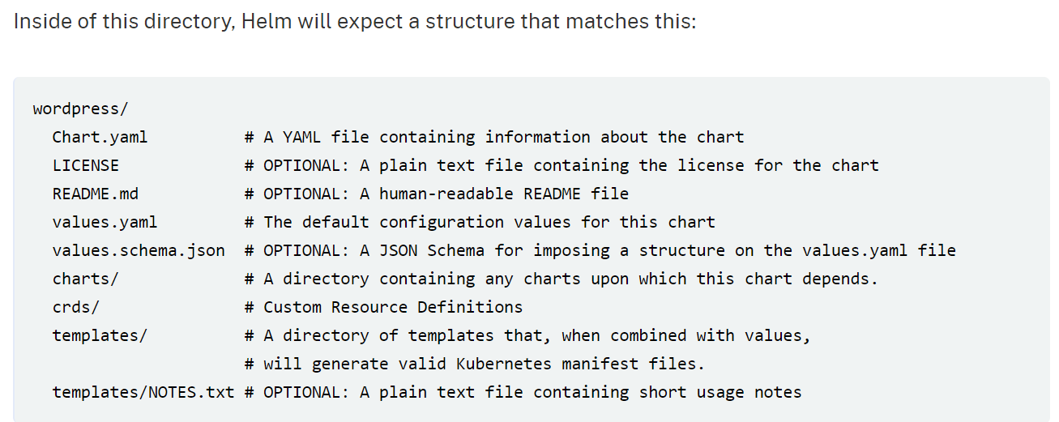
The Chart File Structure
A chart is organized as a collection of files inside of a directory. The directory name is the name of the chart (without versioning information).
Thus, a chart describing WordPress would be stored in a wordpress/ directory.
Inside of this directory, Helm will expect a structure that matches this:
Helm reserves use of the charts/, crds/, and templates/ directories, and of the listed file names. Other files will be left as they are.

Slide 13
Show & Tell Session
  Uploading Helm Chart
  Credential Creation
Notes:
ACL Show & Tell Session to be performed on Time availability.

Slide 14
Corporate HQ
Austin, TX, USA
sales@alepo.com
Follow Us
www.alepo.com
AlepoUSA
@AlepoUSA
Company/Alepo

